Slide 1

MAINTENANCE & SAFETY OF TERMINALS
SHIVANI VINAY WAKADE
YASH PARMAR
AFSAR SAZAULLAH
TANAY ATPADKAR
ADITYA KUMAR JHA
SHUBHANG PRASAD
RAJU BANOTH
SANJAY SOREN
PRAVEEN KUMAR BANOTH

Slide 2

MAINTENANCE

Slide 3
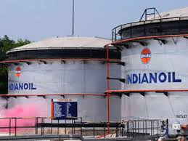
maintenance
CONE ROOF TANKS
Annular plate extensions
Air vent
Water marks on roof
Earthing strip

Slide 4
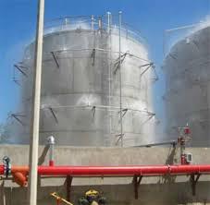
maintenance
Sprinkler systems
Stair case and handrails
Water drains
Sand Pad foundation
Tank cleaning

Slide 5
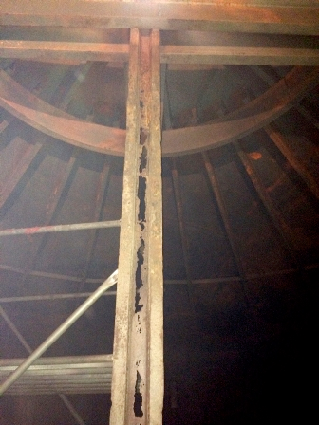

Slide 6
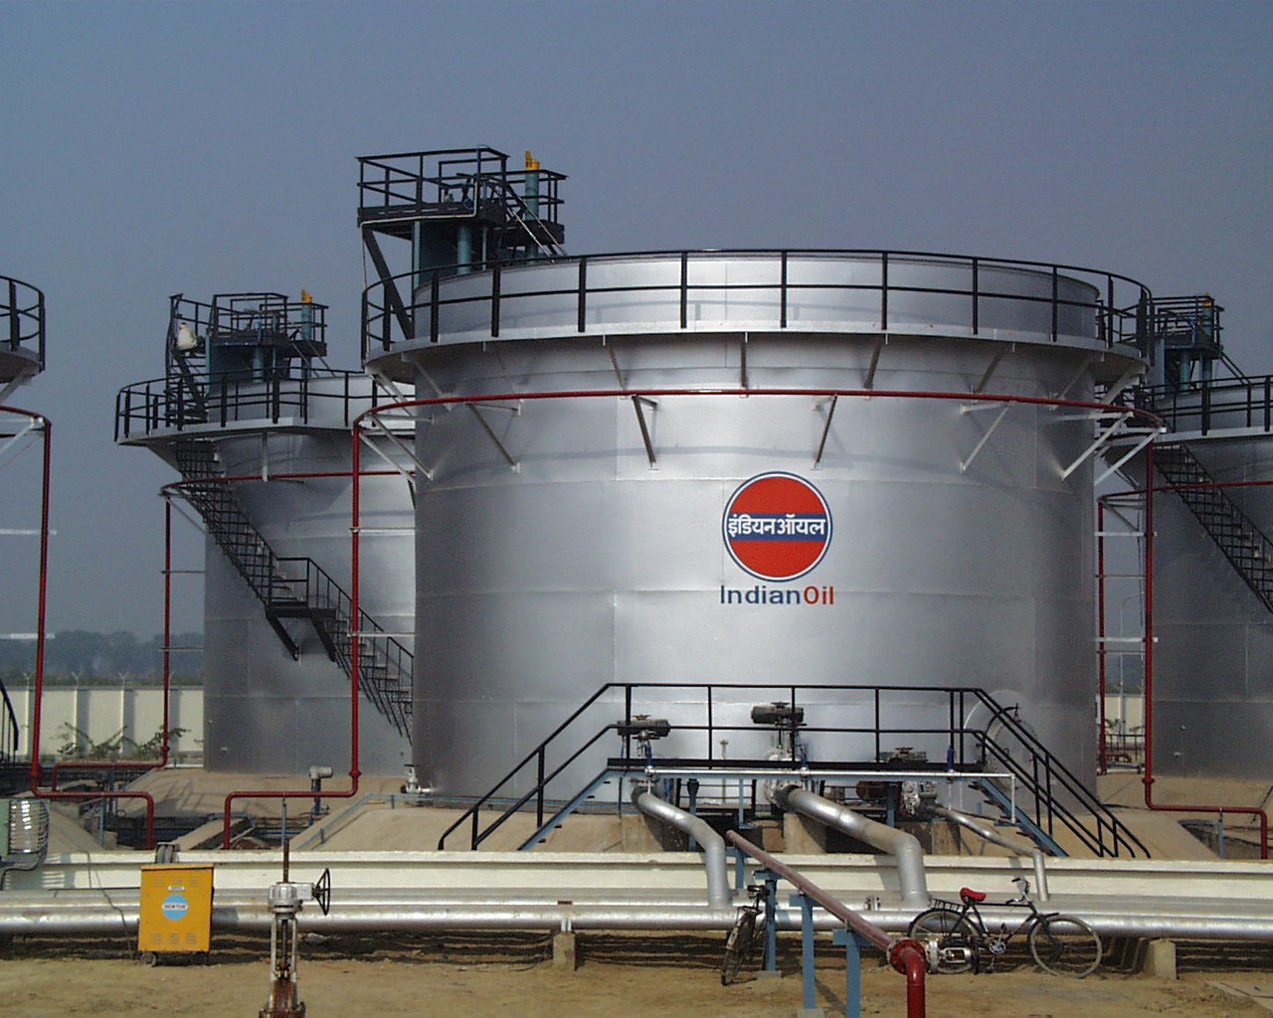
maintenance
FLOATING ROOF
Pontoons
Articulated drains
PV valves
Auto Bleeder vent

Slide 7
maintenance
Sprinkler system
Primary and secondary seal
Foam Dam
Sand Pad foundation
Tank cleaning

Slide 8
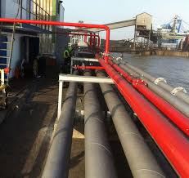
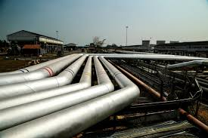
Pipeline maintenance
PIPELINES TYPES
Hydrant Lines
Product Lines

Slide 9
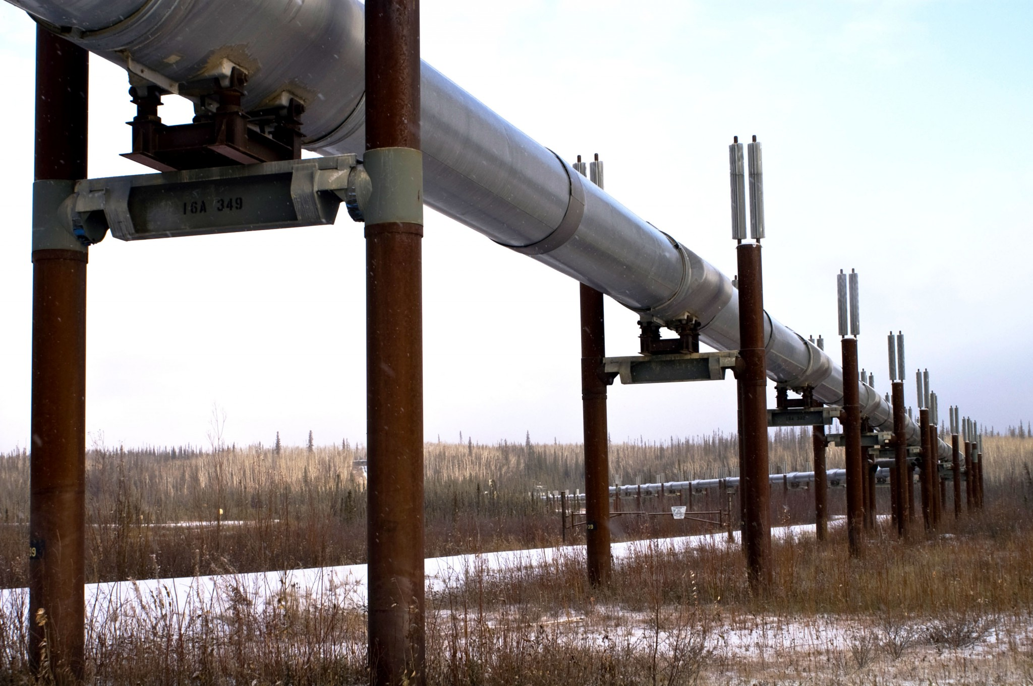
Pipeline Maintenance
Solid rod between pipe and foundation
Guiding rods
Wrapping coating in underground pipeline
Inspection of pipeline foundation
No Vegetation

Slide 10
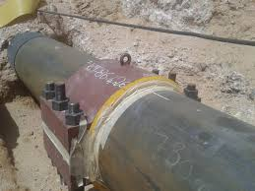
Pipeline Maintenance
Pressure testing
Clamps for leakage
Cathodic Protection
Route Lines

Slide 11
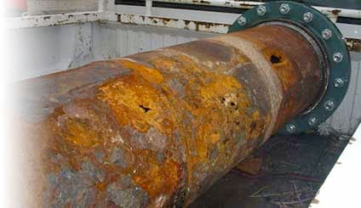

Slide 12
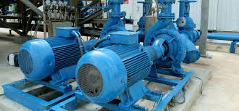
Pumps Maintenance
Strainer Cleaning
Vibration Check
Temperature Checks
Rubber mat

Slide 13
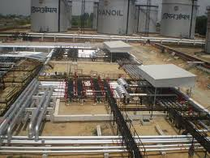
Pumps Maintenance
Flame Protection
Coupling guard
Pump house manifold
Body Earthing

Slide 14
electrical maintenance
Electrical Audit by CEA every 3 years
Periodic change of transformer oil
Periodic replacement of silica gel in transformers

Slide 15
SAFETY

Slide 16
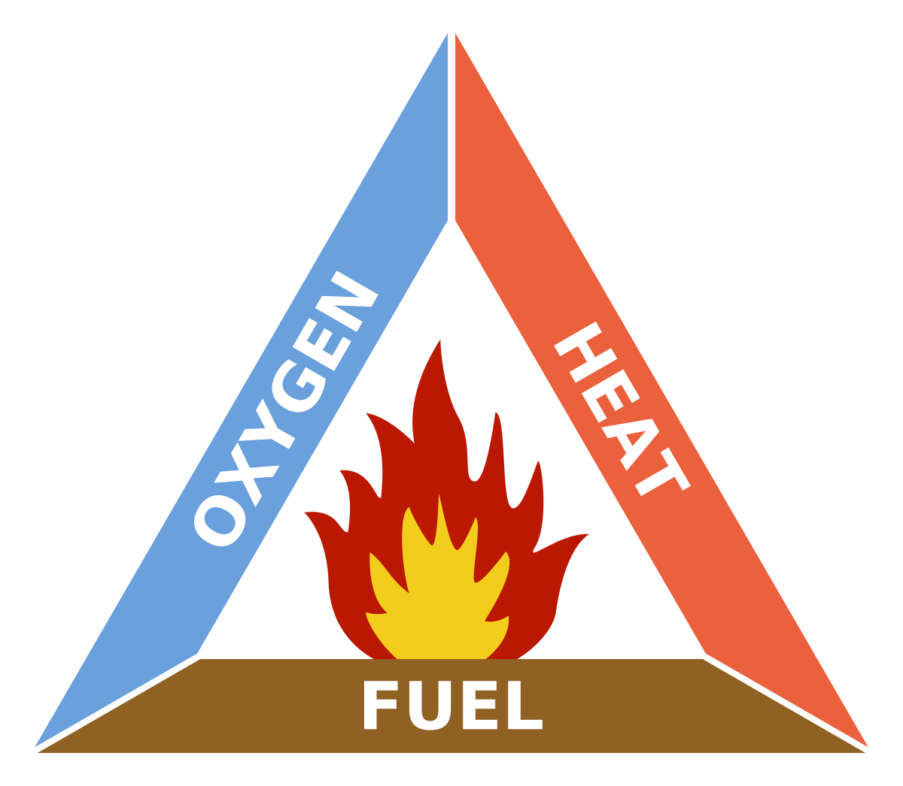
SAFETY

Slide 17
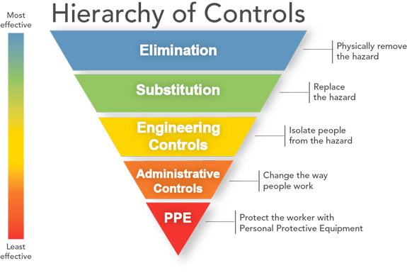
SAFETY

Slide 18
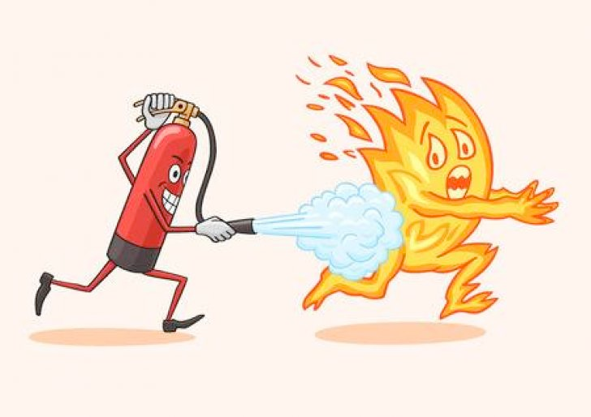
SAFETY EQUIPMENTS
DCP
Medium Expansion Foam Generator (MEFG)
High Velocity Long Range Monitor
Hydrocarbon Detectors
Dyke valve indicator
Level Alarms (HHH, HH, H, L, LL, LLL)

Slide 19
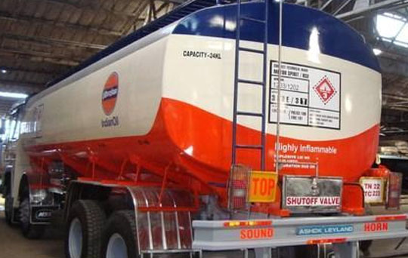
Safety of TT
Hazardous Chemical handling certification
Green Card
Battery cut-off
Master valve
Emergency valve
Safety lock

Slide 20
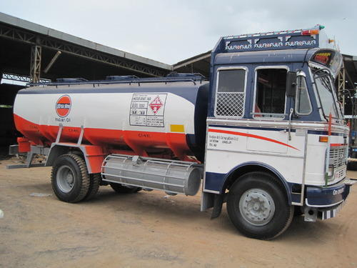
Safety of TT
Spark Arrestors
Space between tanker and driver cabin
Tank size less than drivers cabin
Lead fire safety link
Earthing
Air vent

Slide 21
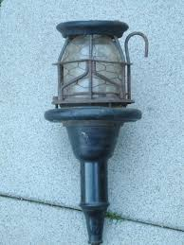
SAFETY
Water Sprinkler System
Emergency Alarms
Fire Water Pump House
Flame Proof Equipments
Earthing

Slide 22
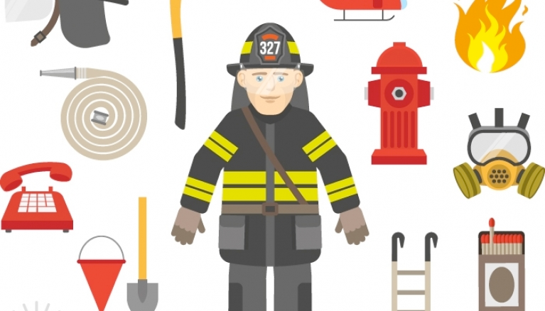
SAFETY
Frisking
Sand Buckets
Follow SOP
PPEs

Slide 23
THANK YOU

